Slide 1
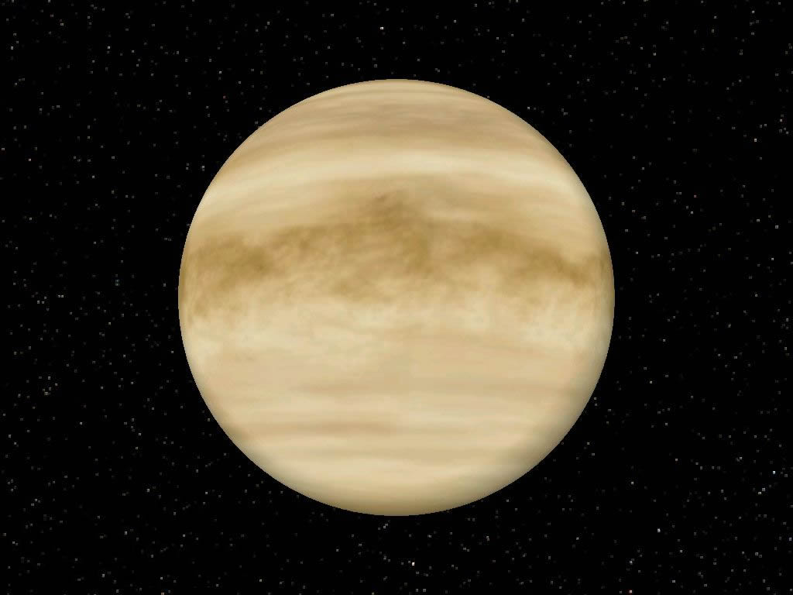
Venus

Slide 2
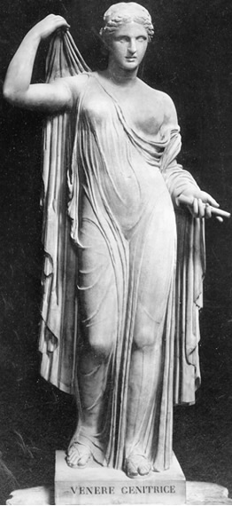
Venus is named after the Roman goddess of love and beauty.
Most ancient civilizations thought Venus was two different stars: one in the evening & one in the morning.

Slide 3
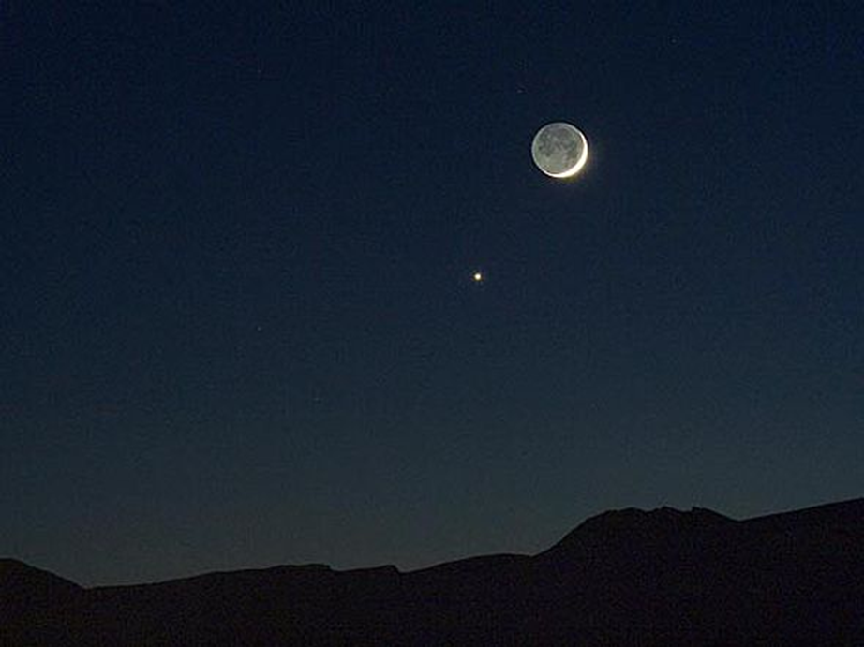
Greeks called the Evening Star Hesperus, who was the son of the dawn goddess.
Greeks called the
Morning Star Phosphorus, which means “light bringer.”
Romans called the Evening Star Vesper, which means “things of the evening.”
Romans called the Morning Star Lucifer, which means “light bringer.”

Slide 4
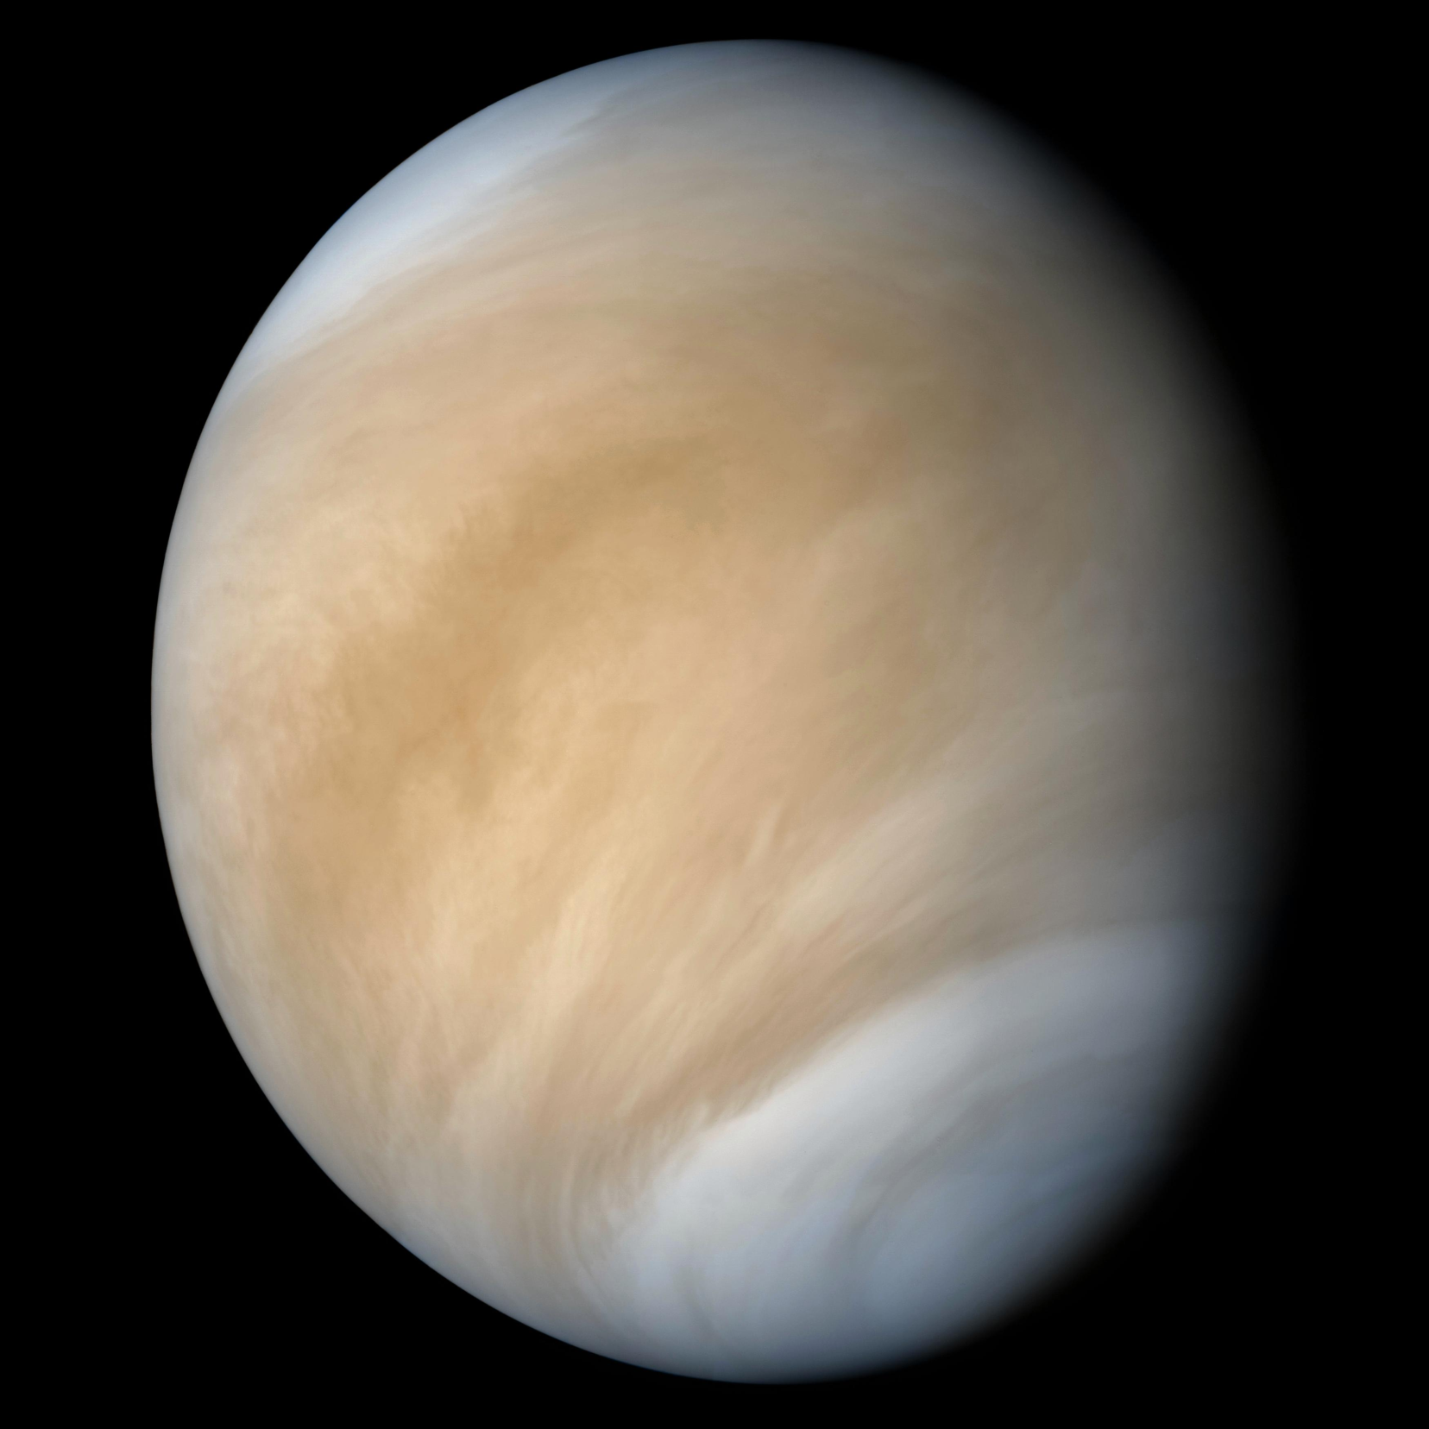
Venus’ thick atmosphere prevents us from seeing any surface features with telescopes.

Slide 5
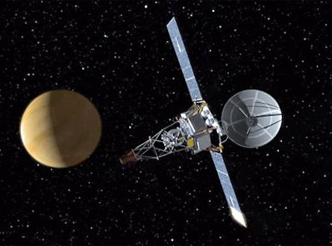
Mariner 2 was the first satellite to visit Venus.
It flew by in 1962. It was the first time a spacecraft visited another planet.

Slide 6
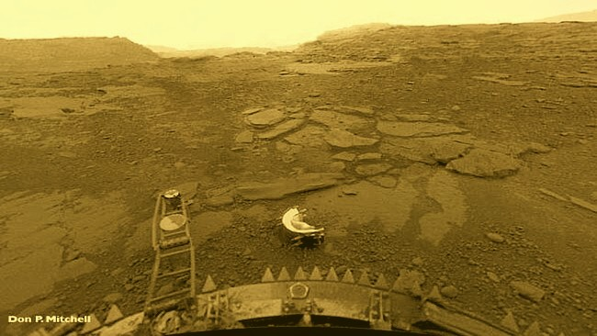
The Russians were the first to land on Venus, with the Venera missions.
In 1970, Venera 7 was the first to successfully land.
In 1975, Venera 9 & 10 were first to send back photos of the surface.

Slide 7
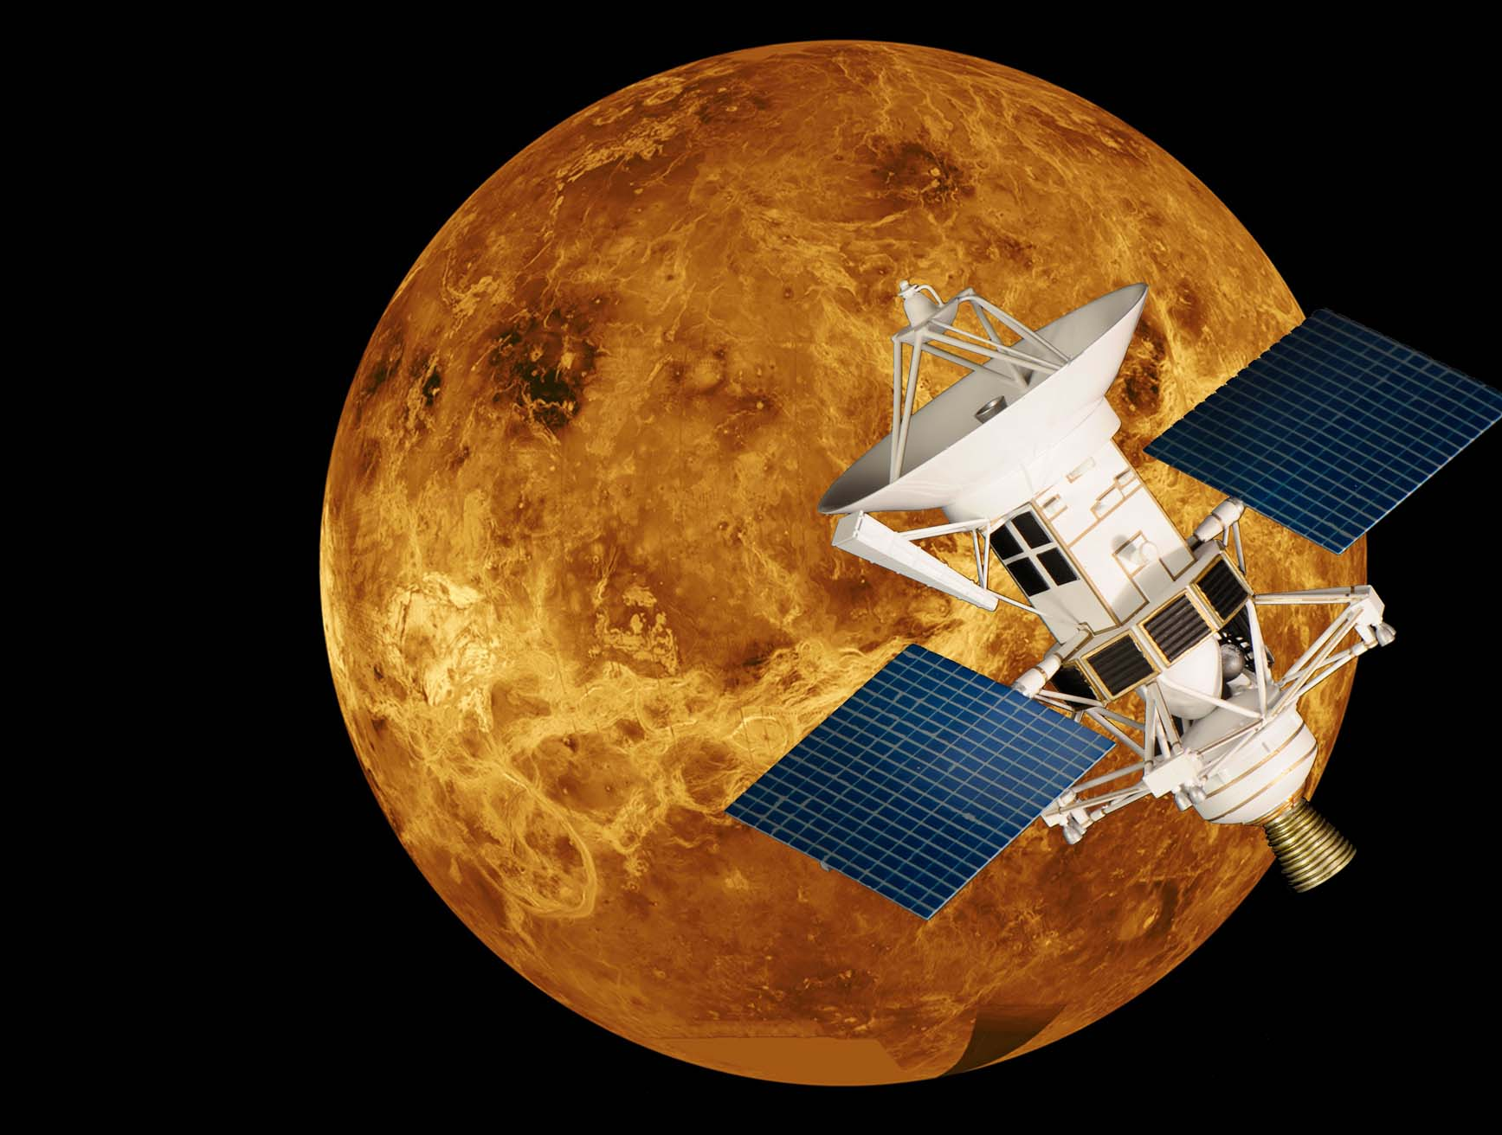
Magellan arrived in 1990 and
mapped
the surface
of Venus.

Slide 8
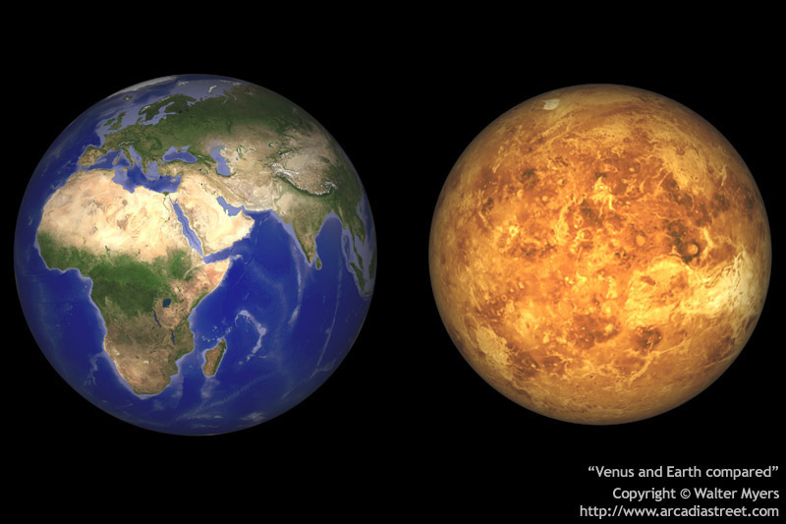
Earth & Venus: Sister planets?
Similar size, mass & composition
Diameter:
7916 miles
Diameter:
7513 miles

Slide 9
Earth & Venus: Sister planets?
Distance from Sun in miles
93 million
67 million
365 days
Orbit
224 days
Rotation
24 hours
1040 mph
Counter Clockwise
243 Earth days
4 mph
Clockwise

Slide 10
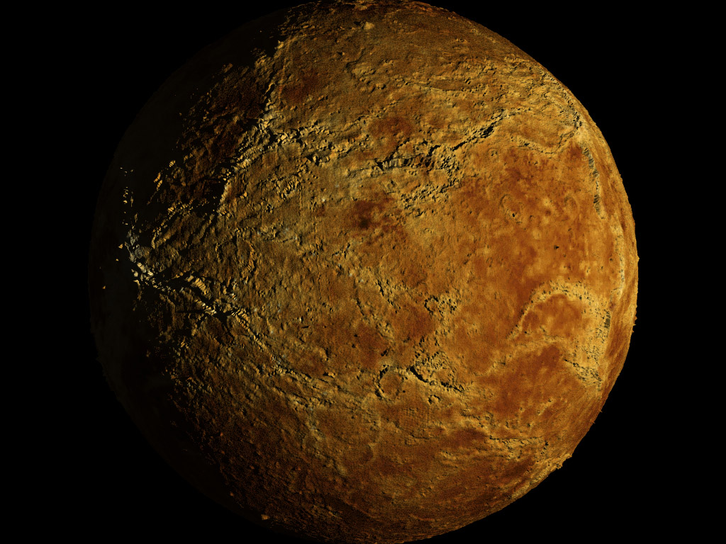
Venus:
Hottest planet
Slowest rotating planet
Only planet rotating clockwise

Slide 11
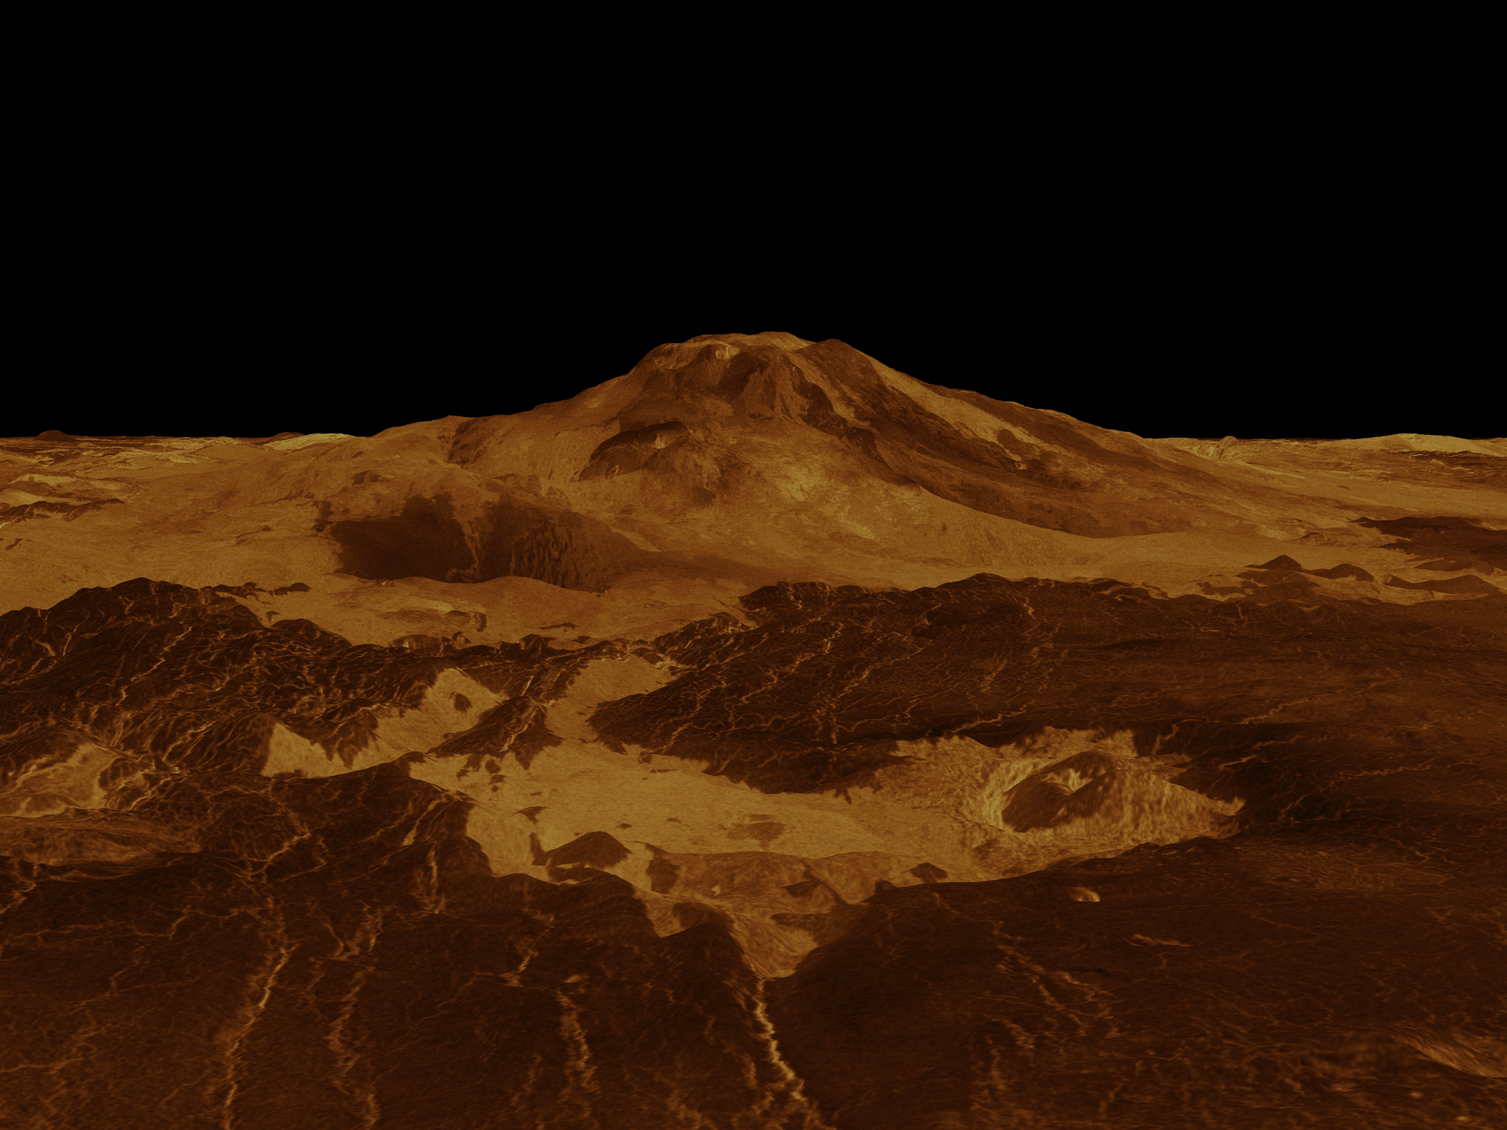
Venus Atmosphere:
Greenhouse Effect Gone Wild!
The Sun’s heat boiled away any oceans & water that might have existed.
Carbon dioxide filled the atmosphere.
With no water, there are no plate tectonics. With no plate tectonics, carbon stays on surface instead returning underground.
Carbon on surface is baked out, adding to atmosphere & trapping even more heat.

Slide 12

Venus Atmosphere:
Greenhouse Effect Gone Wild!
96% carbon dioxide, 3.5% nitrogen
93 times more dense than Earth
  Earth sea level pressure is 15 ppsi
  Venus surface pressure is 1,300 ppsi (the same as 3,000 ft underwater)
Clouds of sulfuric acid
Lightning, thunder & 167 huge volcanos

Slide 13
Venus Atmosphere:
Greenhouse Effect Gone Wild!
Average temperature: 870⁰ F
  Enough to melt lead, magnesium, silver & zinc
  Hotter than temperatures we use to sterilize things

Slide 14
Venus Atmosphere:
Greenhouse Effect Gone Wild!
Clouds & thick atmosphere block 80% of sunlight. Venus is in perpetual twilight.
Winds can only blow 2-3 mph, but air is so dense that it can blow rocks & stones.

Slide 15
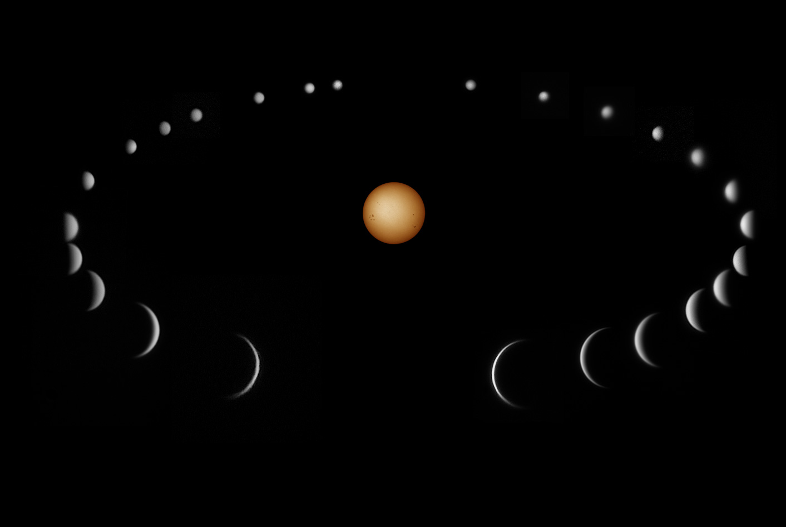
From our perspective, Venus goes through phases like the Moon.

Slide 16
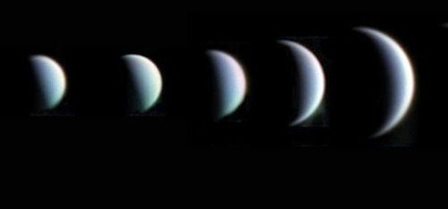
The phases of Venus
Galileo was the first to discover this. He used it to help bolster his argument that the planets don’t rotate around the Earth.

Slide 17
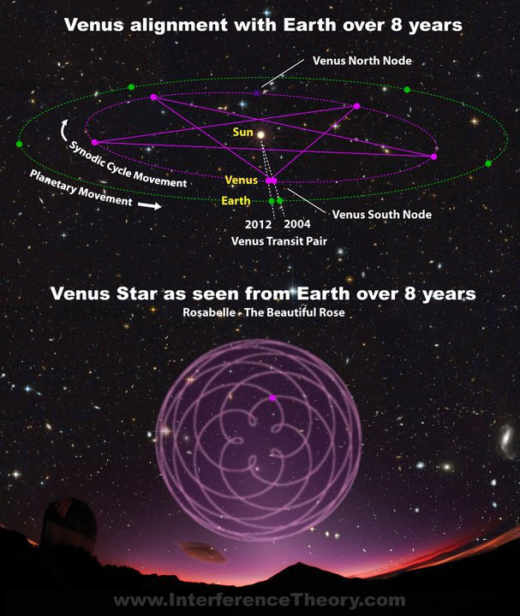
The Venus Pentagram:
over 8 years, the path of Venus in the sky makes this design.

